Slide 1
Tutorial on VoiceSauce - A program for voice analysis
Yuan Chai
University of California Los Angeles
yuanchai@g.ucla.edu
02/10/2023

Slide 2
Goal of the workshop
Have a basic understanding of the rationale and usage of VoiceSauce;
Get hands-on experience of using VoiceSauce to process audio files;
Visualize and interpret data in Excel
(Try some visualization using R code!)

Slide 3
What is VoiceSauce
VoiceSauce is a software that can be used to analyze acoustic measurements related to voicing.
Compared to Praat, VoiceSauce specializes in measuring parameters related to voice quality:
Spectral tilt (H1-H2, H2-H4), noise (HNR), voicing amplitude (SoE). Those measures indicate whether there is glottal constriction or F0 irregularity in the voicing.
VoiceSauce can also calculate measures that Praat can calculate:
Pitch (F0), vowel formant, duration, intensity (RMS Energy)

Slide 4
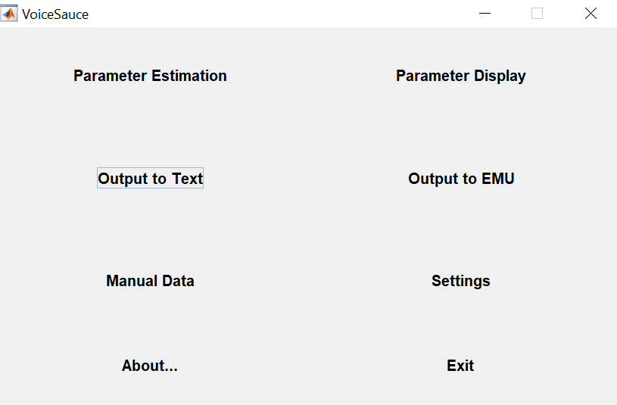
What does VoiceSauce look like
If you want to visualize the data in VoiceSauce
Step 2
Step 3
If you spot errors in the output and want to manually add data
Step 1

Slide 5
Output from VoiceSauce
VoiceSauce output one datapoint every 1 millisecond.
You can choose to either output all the datapoints, or only the mean.
VoiceSauce can divide a sound file into several intervals and calculate a mean for each interval.

Slide 6
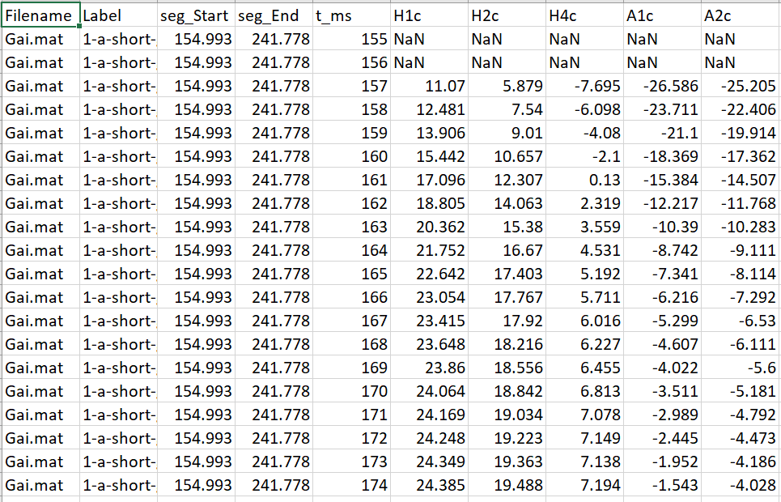
All data points:

Slide 7
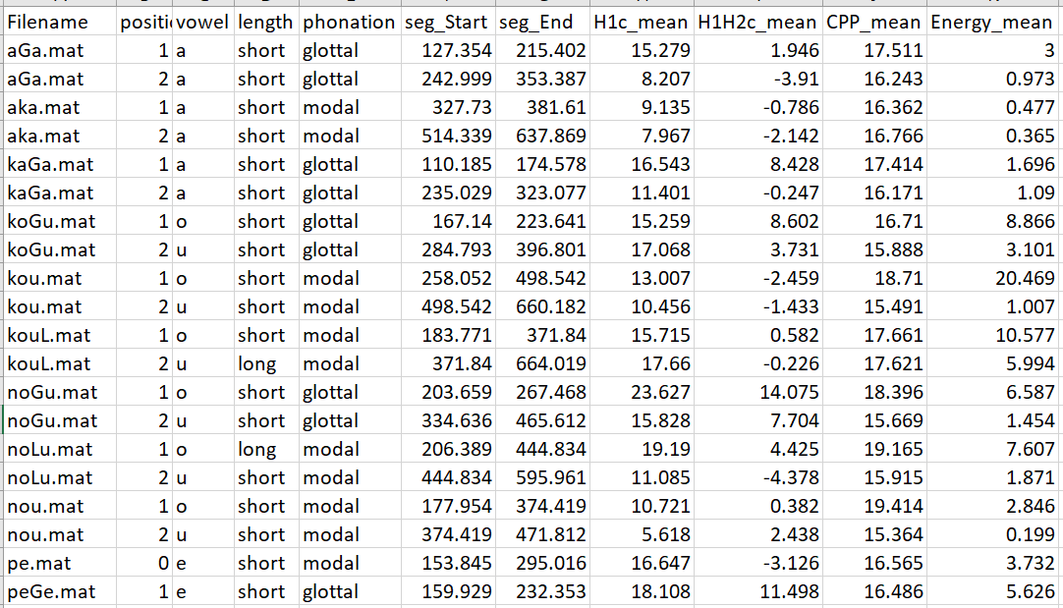
Just the mean

Slide 8
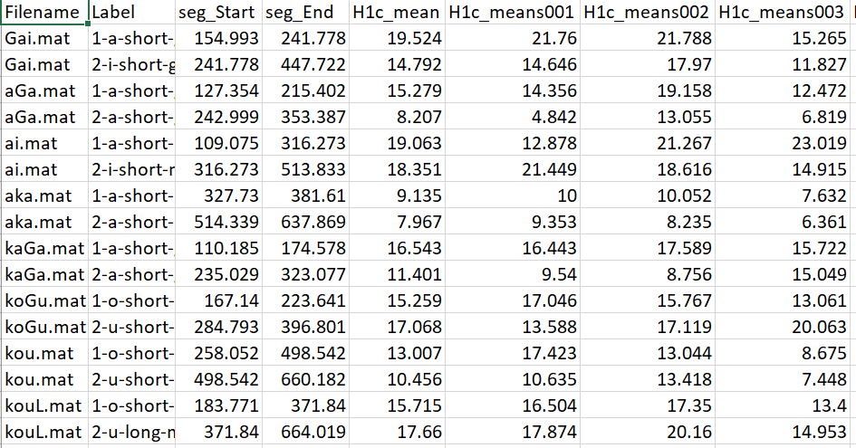
Means of three equal intervals for each file

Slide 9
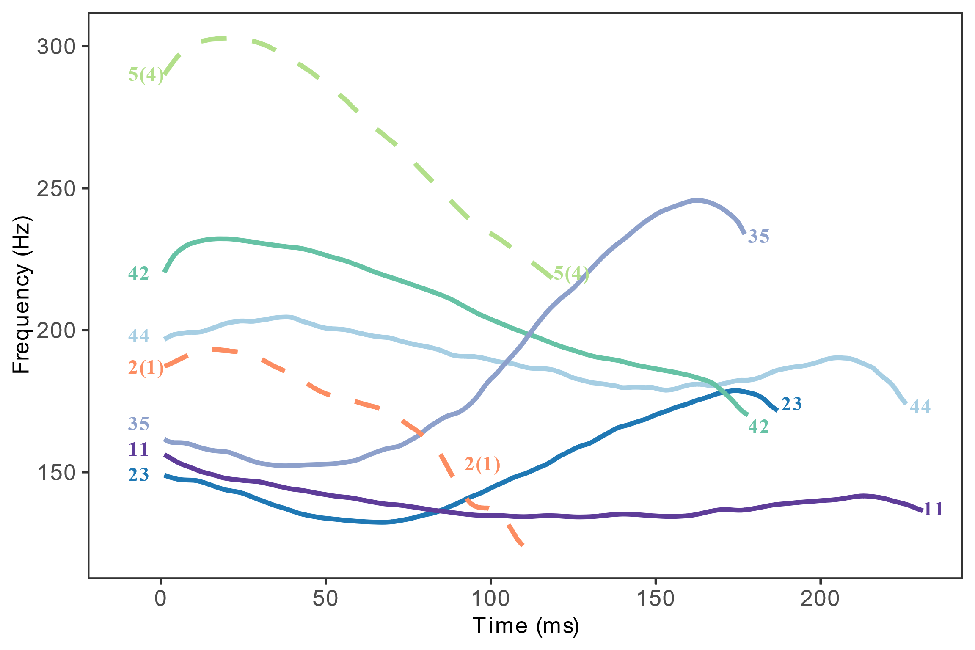
What can you draw/analyze using output from VoiceSauce
Pitch track (F0 track of the seven tones in Xiapu Min)

Slide 10
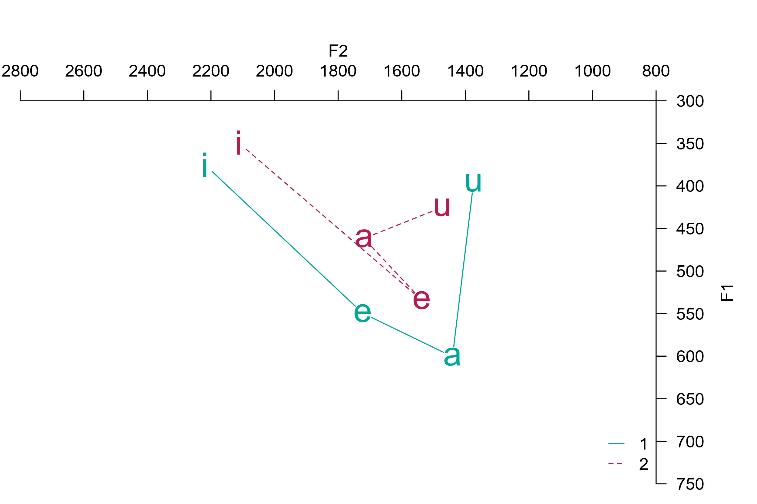
What can you draw/analyze using output from VoiceSauce
Vowel chart (stressed and unstressed vowels in Cahuilla)

Slide 11
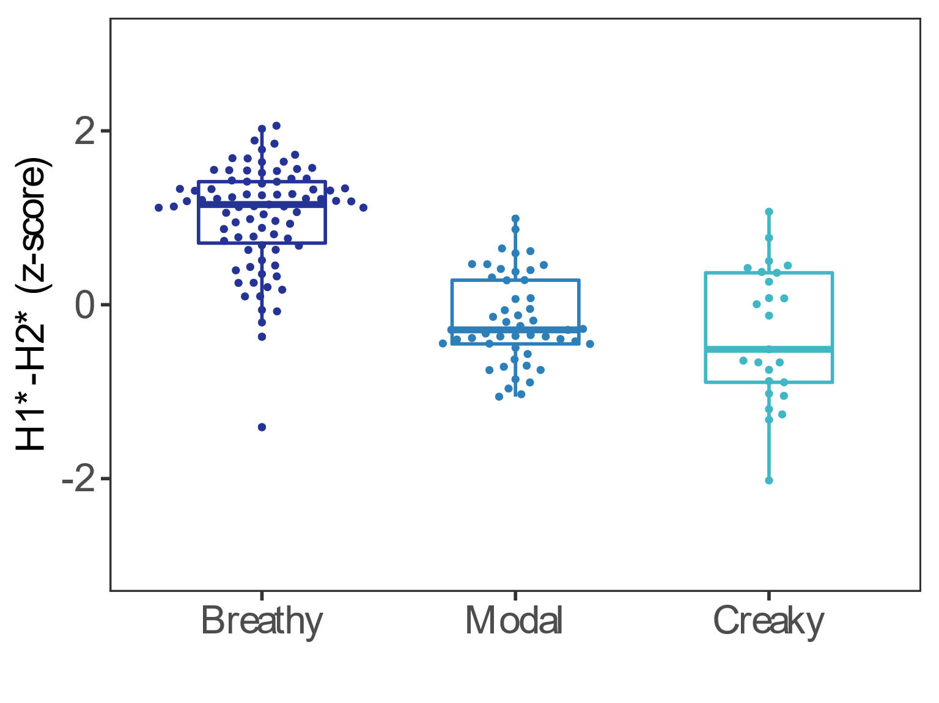
What can you draw/analyze using output from VoiceSauce
Boxplots of various measures

Slide 12
How to download and use VoiceSauce
Windows users: Standalone .exe file
Mac users: Install Matlab and run the scripts in Matlab
Refer to https://yuanchaiyc.github.io/website/subpages/VS-tutorial.html for detailed installation instructions

Slide 13
Case study for today
The acoustics of V and VʔV in Hawaiian
Hawaiian has phonemic glottal stop:
aha | “what”
ʔaha | “line, life”
noːu | “yours”
noʔu | “mine”
(The UCLA Phonetics Lab Archive)

Slide 14

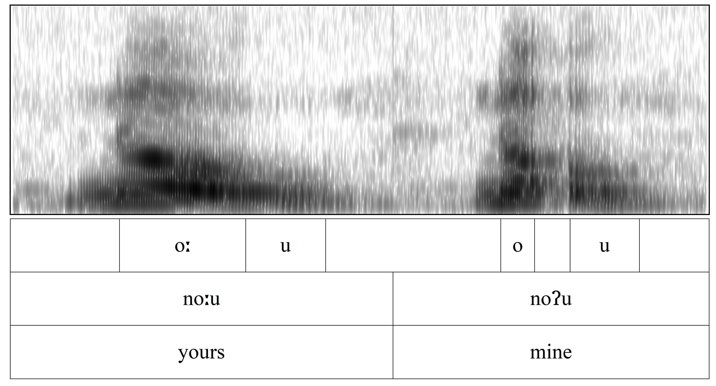
Case study for today
Research question: Are the vowels surrounding the glottal stop creakier than the plain vowels?
noːu vs. noʔu

Slide 15
Getting started
Prepare data in Praat
Create a Textgrid
Segment and annotate the target segment
Save the Textgrid
either as for the whole recording
or split the recording into individual target words – RECOMMENDED
You can use Praat scripts or Praat plugins to chop a long recordings into smaller chunks. Come talk to me if you want to know more about the tools!

Slide 16
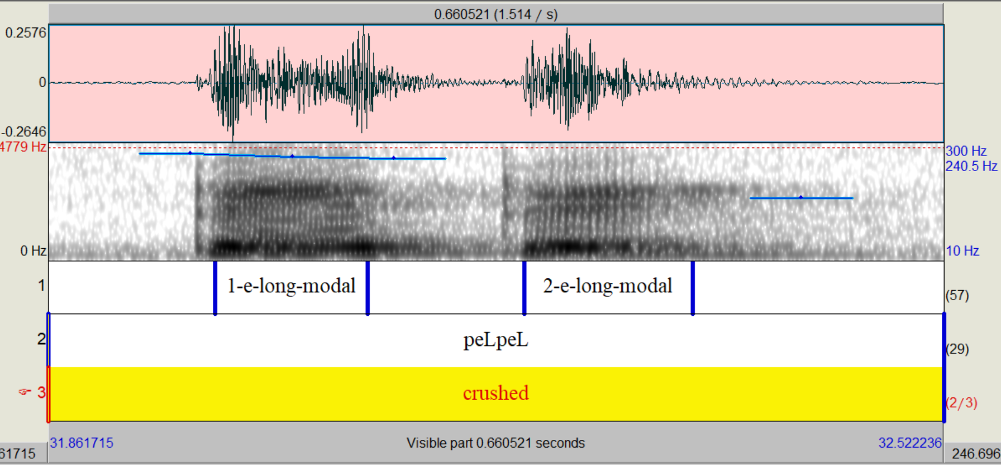
Getting started

Slide 17
Getting started
Download the preprocessed data here:

Slide 18
Pass on the .wav and .Textgrid to VoiceSauce
Step 1

Slide 19
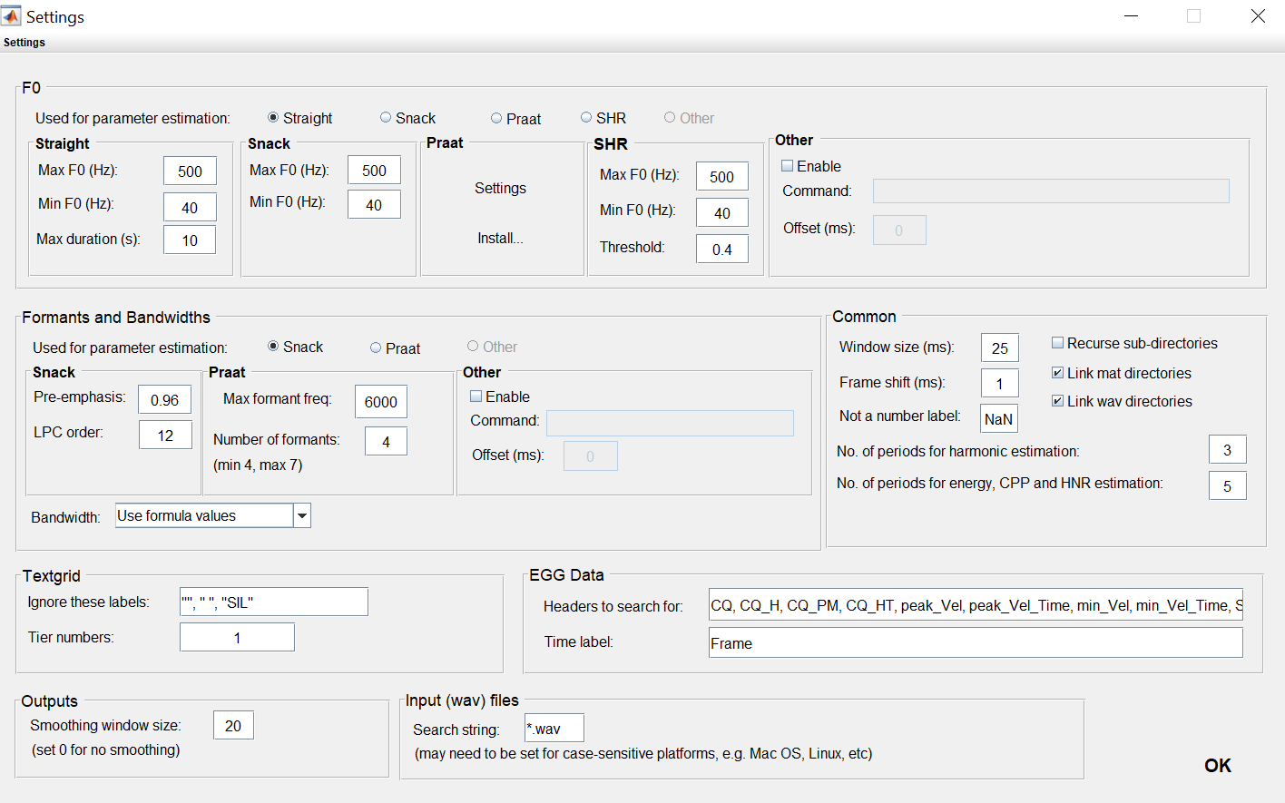
Step 1: Settings

Slide 20
Step 2: Parameter estimation
Step 2

Slide 21
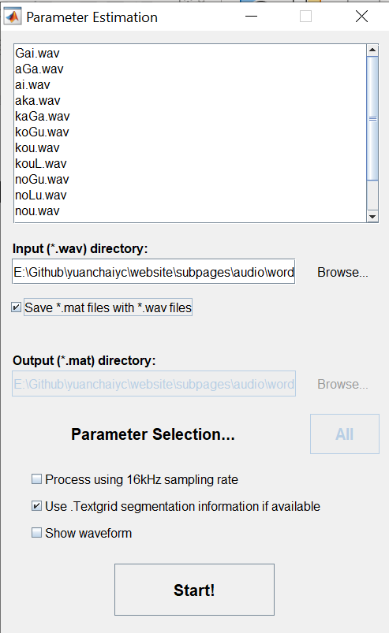

Slide 22
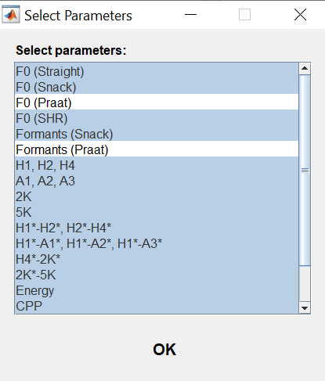
Step 2: Parameter estimation
If you are using Matlab online, make sure you deselect all the measures involving Praat.

Slide 23
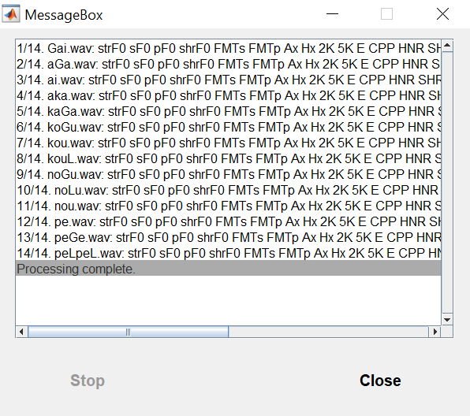
Step 2: Parameter estimation

Slide 24
Step 3: Output to text
Step 3

Slide 25
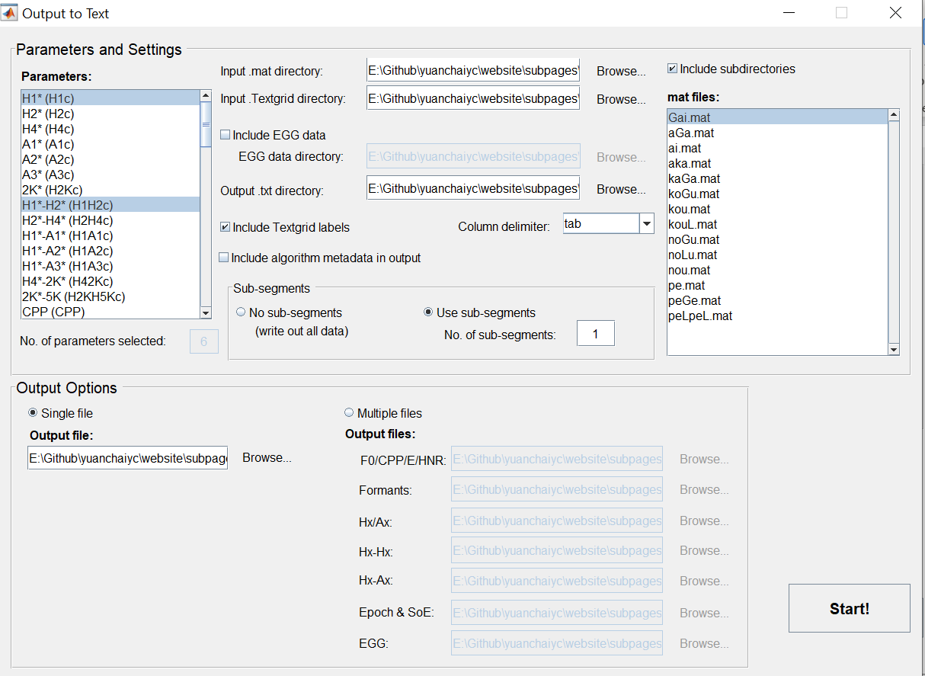
Parameters to select for today:
H1*
H1*-H2*
HNR05
strF0
sF1
sF2
SoE

Slide 26
Step 4: Visualize the output in Excel
Open output.txt in Excel
If you have trouble opening the txt file, you can open the prepared output.xlsx in the folder that you downloaded.

Slide 27
Step 4: Visualize the output in Excel
Draw boxplots
Select “phonation” and “H1-H2”
Go to Insert → Charts → Box & Whisker
Press “OK”

Slide 28
Step 4: Visualize the output in Excel
Draw vowel chart

